Slide 1
Characters
The 5 Character Traits

Slide 2
What do Characters Represent?
Stories are less about what happens and more about whom they happen to.
The reason we can become so interested in fictional characters is because they aren’t completely fictional.
For a reader wrapped up in a story, they represent real people(sometimes ourselves) facing real problems in the real world.
And this is exactly how you should try to experience them as you read.

Slide 3
The Key to Unlock the Meaning
Every main character is challenged in some way. One way of looking at this challenge is to see it as a situation in which a character’s abilities and experience are insufficient to solve the problem at hand. It is by engaging in these challenges, overcoming some, succumbing to others, that characters develop; they change as a result of what happens to them as they try to solve their problems and reach their goals. And it is this change, or set of changes, that often holds the key to unlocking a story’s meaning.

Slide 4
Let’s Look at the 5 Traits

Slide 5
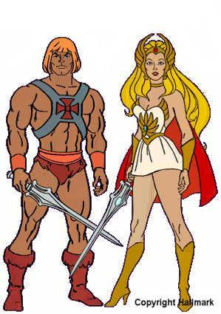
Physical
What does the character look like?
How do the character’s physical attributes play a role in the story?
How does the character feel about his or her physical attributes?
How does the character change physically during the story?
How do these changes affect the character’s experience?
What is his or her age?

Slide 6
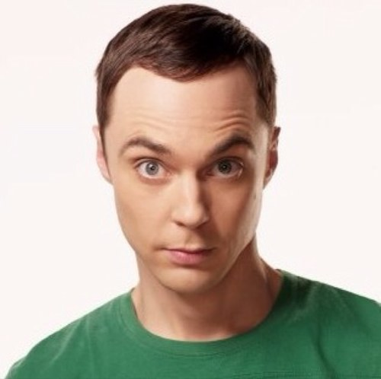
Intellectual
How would you describe the character’s intelligence?
What does the character know?
How does the character’s intellect compare to others in the story?
Is the character smart enough to thrive in the world in which he or she lives?
What does the character learn as the story develops?

Slide 7
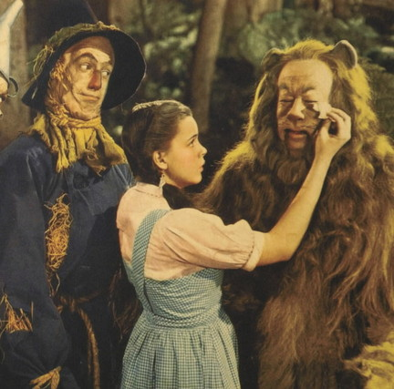
Emotional
How does the character feel most of the time? How do his or her feelings change throughout the story? How does the character feel about himself or herself? When faced with challenges in the story, what emotions come up for this character?

Slide 8
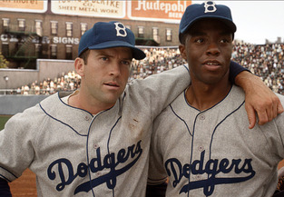
Social
How does the character get along with other characters in the story? Who does the character choose for friends and why does the character choose them? Where does the character stand in the social order? How do the character’s social standing affect events in the story? What is the characters family life? Does the character have a job or career -- does this play a role in his social life?

Slide 9
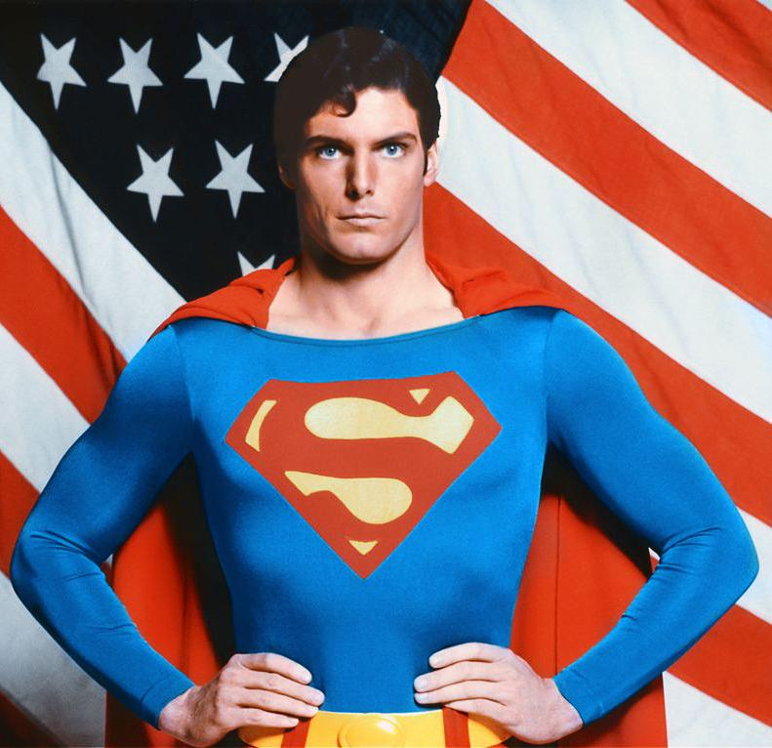
Philosophical
What does the character believe about the way life is? What are these beliefs based on? How do these beliefs affect the choices the character makes? How do those beliefs change throughout the story? Do others in the story share these beliefs?

Slide 10
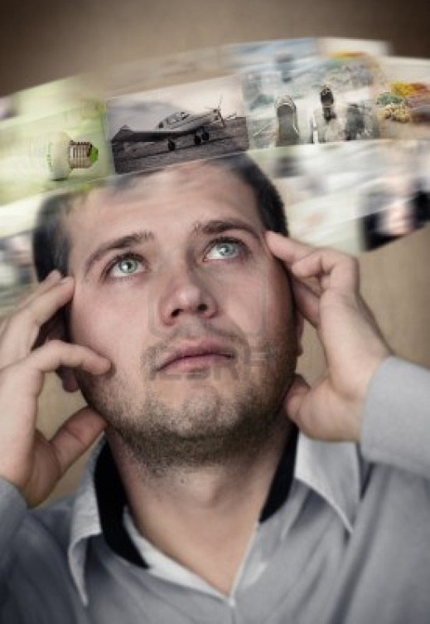
So WHAT?
Ultimately, the big question I hope you think about is this: What can we learn from this character about how to live in the world? The greatest value in fiction, lies in what we can learn about our own lives when we take time to analyze someone else’s — even if that someone else is just a character in a story.

