Slide 1
Argumentation
Logos
Ethos
Pathos
The goal of argumentative writing/speaking is to persuade your audience that your ideas are valid, or more valid than someone else's. The Greek philosopher Aristotle divided the means of persuasion, appeals, into three categories--Ethos, Pathos, Logos.

Slide 2
Ethos Definition
Ethos (Credibility), or ethical appeal, means convincing by the character of the author.
We tend to believe people whom we respect. One of the central problems of argumentation is to project an impression to the reader that you are someone worth listening to, in other words making yourself as author into an authority on the subject of the paper, as well as someone who is likable and worthy of respect.

Slide 3
Ethos: Ethical Appeal
Arguments based on character
Claiming authority
Establishing credibility
Acknowledging motives

Slide 4
What Could They Sell?
For each of the following public figures, choose
A product or campaign that would benefit from their endorsement
A product or campaign that would not benefit

Slide 5
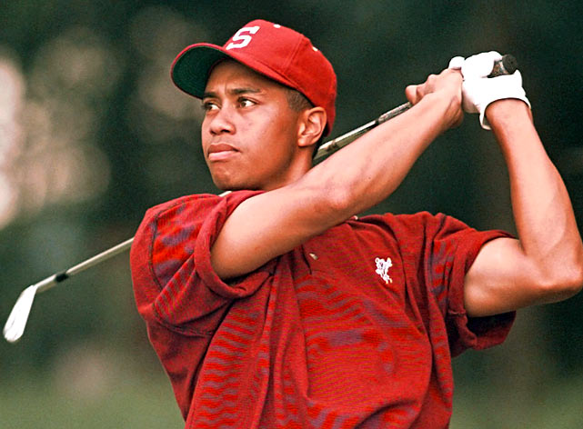
Tiger Woods

Slide 6
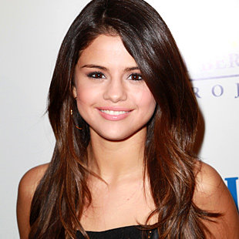
Selena Gomez

Slide 7
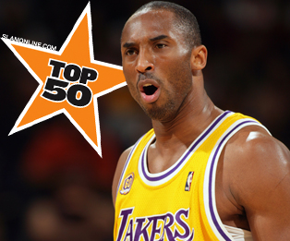
Kobe Bryant

Slide 8
Liam Hemsworth

Slide 9
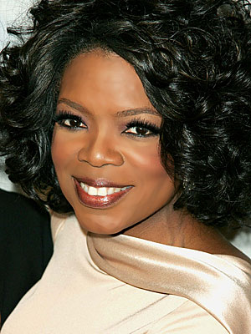
Oprah Winfrey

Slide 10
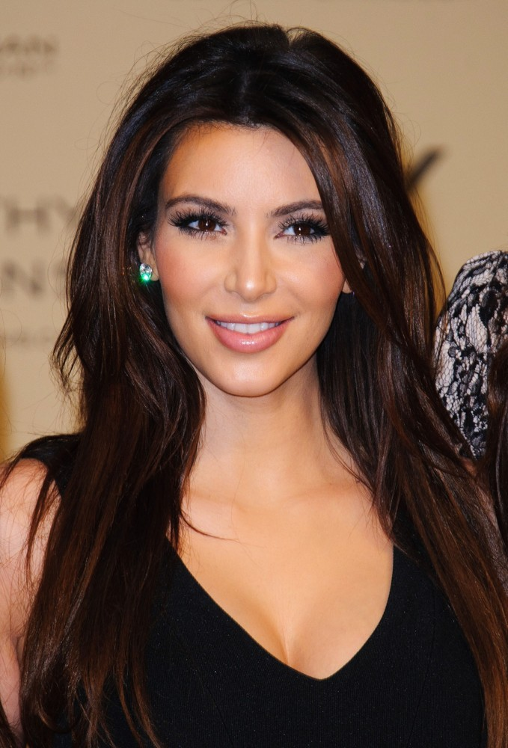
Kim Kardashian

Slide 11
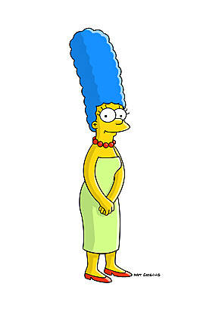
Marge Simpson

Slide 12
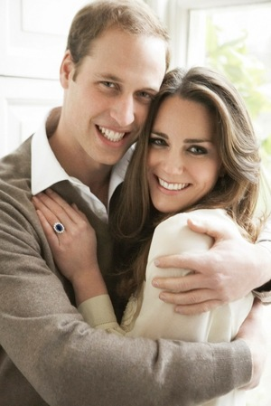
Prince William & Kate Middleton

Slide 13
Pathos Definition
Pathos (Emotional) means persuading by appealing to the reader's emotions.
We can look at texts ranging from classic essays to contemporary advertisements to see how pathos, emotional appeals, are used to persuade. Language choice affects the audience's emotional response, and emotional appeal can effectively be used to enhance an argument.

Slide 14
Pathos: Emotional Appeal
Arguments based on emotion
Using emotions to build bridges
Using emotions to sustain arguments
Using humor (with caution)

Slide 15
To what specific emotions do these slogans appeal?
“Have it your way” (Burger King)
“Just do it” (Nike)
“Yes we can!” (Obama ‘08)
“Country first” (McCain ‘08)
“Know what comes between me and my Calvins? Nothing!” (Calvin Klein Jeans)

Slide 16
Logos Definition
Logos (Logical) means persuading by the use of reasoning.
This will be the most important technique we will study, and Aristotle's favorite. We'll look at deductive and inductive reasoning, and discuss what makes an effective, persuasive reason to back up your claims. Giving reasons is the heart of argumentation, and cannot be emphasized enough. We'll study the types of support you can use to substantiate your thesis, and look at some of the common logical fallacies, in order to avoid them in your writing.

Slide 17
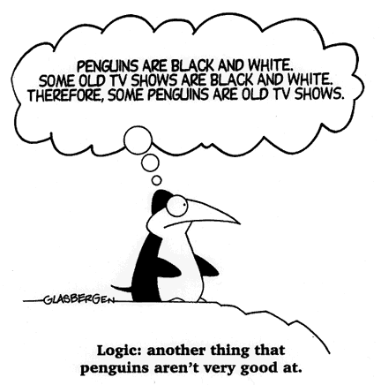
Logic
https://www.youtube.com/watch?v=zrzMhU_4m-g

Slide 18
Logos: Appeal to Logic
Arguments based on facts and reason
Two kinds:
Hard Evidence
Reason and Common Sense

Slide 19
Logos: Hard Evidence
Facts
Statistics
Surveys/Polls
Testimonials and Narratives

Slide 20
Logos: Reason and Common Sense (Rational Appeal)
Argument by Degree
Argument by Analogy
Argument by Precedent

Slide 21
Logical Structures for Argument: Degree
More of a good thing is desirable.
Less of a bad thing is desirable.
If I can get a 10 year warranty on a humble Kia, shouldn’t I get the same or better warranty from a Lexus?
Better a conventional war now than a nuclear confrontation later.
The health benefits from using stem cells in research will surely outweigh the ethical risks.

Slide 22
Logical Structures for Argument: Analogies
A complex or extended comparison
See Friedman, “9/11 and 4/11”

Slide 23
Logical Structures for Argument: Precedent
A comparison over time
If motorists in most other states can pump their own gas safely, surely the state of Oregon can trust its own drivers to be as capable. It’s time for Oregon to permit self-service gas stations.

Slide 24
Logical Structures for Argument: Precedent
Fifty years ago, women wearing men’s clothing, such as pants, was taboo and unthinkable, and co-ed gym class was an inconceivable concept. Imagine how ridiculous a notion those ideas must have been then. I don’t think society will crumble now if we allow all genders to use the same bathrooms in college. Gender-segregated bathrooms are an example of an attempt to hold onto the past, but we are in a new age of equality. Why not create some equally accessible bathrooms?
-Gilad Skonick, The Massachusetts Daily Collegian

Slide 25
Hard Evidence or Rational Appeals?
The bigger they are, the harder they fall.
Drunk drivers are involved in more than 50% of traffic deaths.
History proves that cutting tax rates increases government revenues because people work harder when they can keep more of what they earn.
Polls suggest that a slim majority of Americans favor a constitutional amendment to ban same-sex marriages.
The only thing we have to fear is fear itself.
Airbags ought to be removed from vehicles because they can kill young children and small-frame adults.

Slide 26
Examples in Advertisement

Slide 27
Ethos
Advertising that uses Ethos relies on authority or celebrity. When Michael Jordan became the spokesperson for Nike, it was an ethical appeal because it implied that if a person wore that sneaker, they could be as good an athlete as Michael Jordan. Ethos also appears in advertisements that use doctors to endorse medical products, or those that use "seals of approval" like when cars are endorsed by JD Powers and Associates.
http://www.ispot.tv/ad/7Vzh/5-hour-energy-doctors-review

Slide 28
Pathos
Pathos relies on emotion. It can be positive ("Every Kiss Begins with Kay" for Kay jewelers = This product will get you love) or negative (think of the fear-mongering in political campaign ads). Pathos ads are not logical; instead, they prey upon people's desires to be loved and kept safe.
http://www.youtube.com/watch?v=1VM2eLhvsSM

Slide 29
Logos
Logos is an appeal that is based on making a person's life BETTER or EASIER. Advertisements that use logos promise you are getting the quickest, most convenient, or best product. They often use superlatives like -er or -est. For example, Brawny paper towels are "The Quicker Picker Upper" = other paper towels are "slower" at doing the job. Also, Burger Kings "Have it Your Way" campaign was an example of Logos because it implied a customization--have your food how you like it--versus other restaurants that just gave it to you pre-packaged.
http://www.youtube.com/watch?v=qkJTZqD6R7k

